Slide 1
Caption
Notes:
What did you do?
Why did you do it?
Who did you do it for?

Slide 2
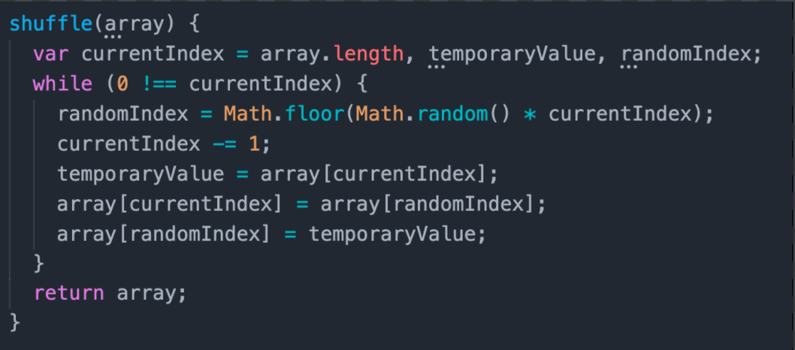
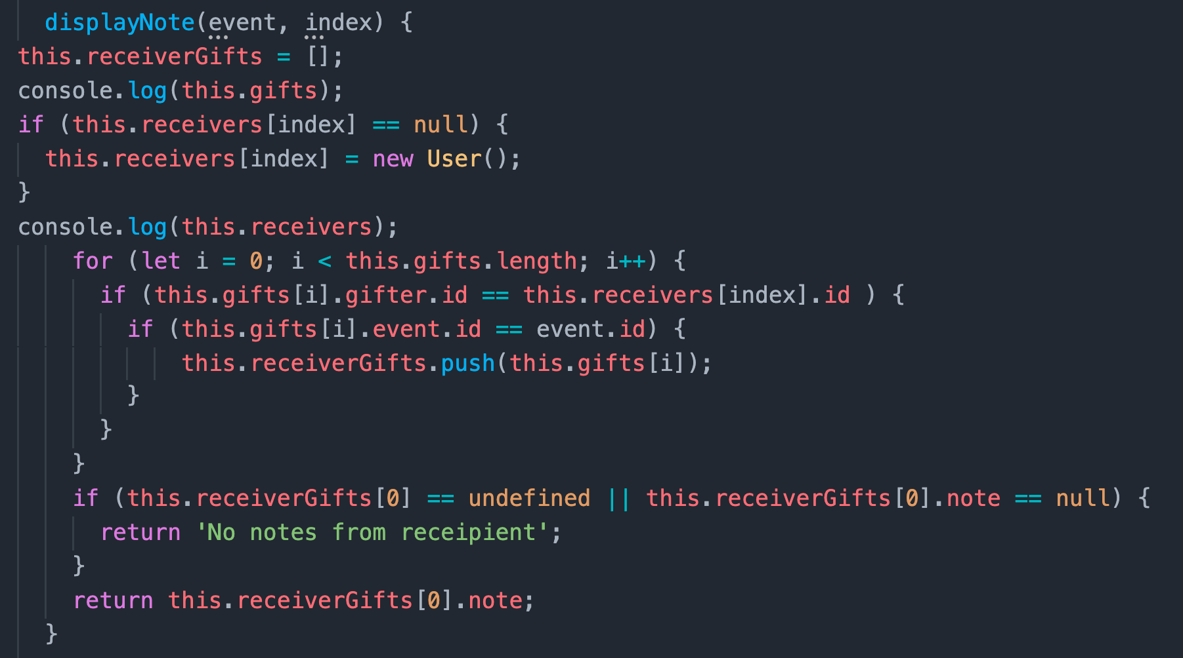
Notes:
How did you do it?
CODE

Slide 3
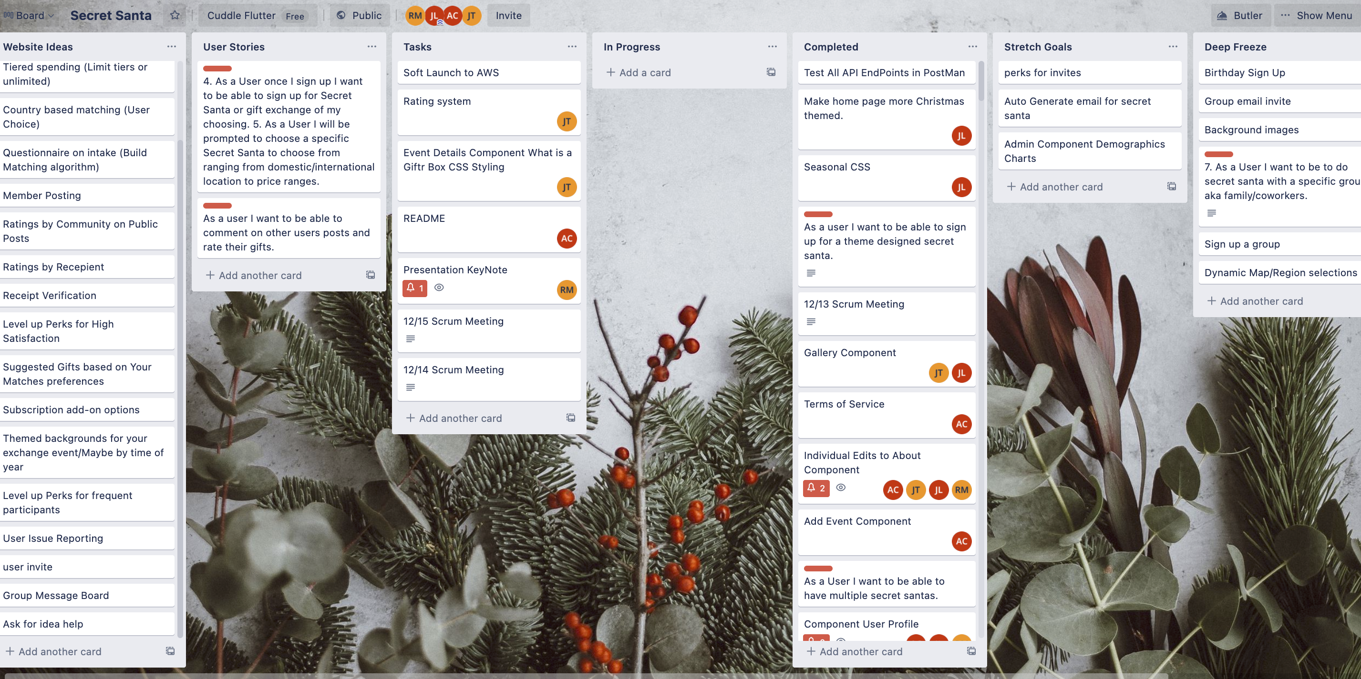

Slide 4
Whats left?
Private Events
Rating System
Admin Dashboard
Notes:
What do you still have to do?
Private events
Rating system
Dashboard

Slide 5
Looking back…
Admin Page
Reprioritizing Pages
Notes:
Knowing what you know now, what would you have done differently?
. Started with admin page sooner
.reprioritized importance of pages.
Planed the site differently

Slide 6
Caption

